Slide 1
BUCS(Bad USB challenge system)
Alex Bladow, Jensen Miller, Mitchell White

Slide 2
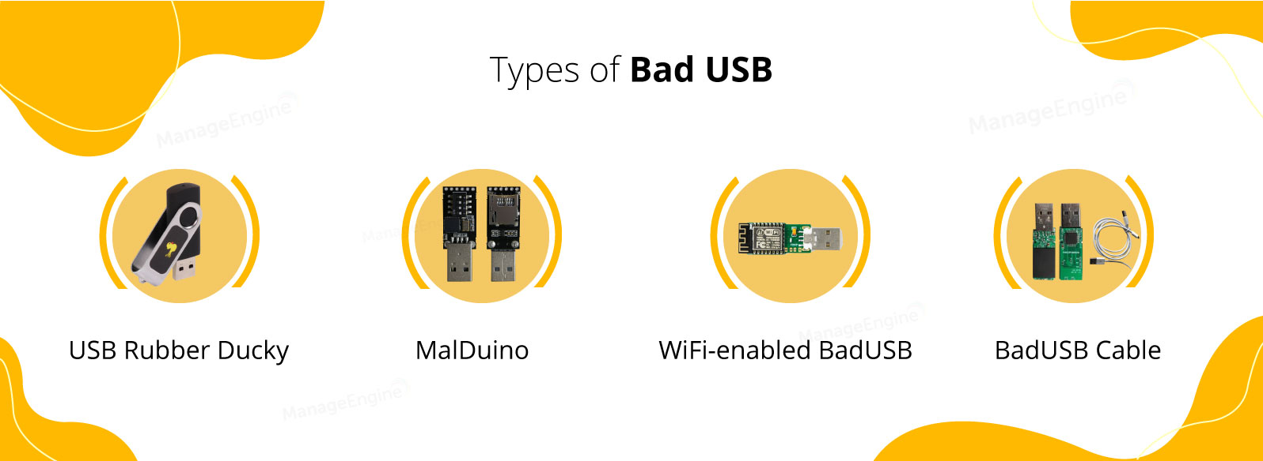
The problem
BadUSBs
Hot plug devices
Automates typing
Can do anything a user could on a keyboard
Innate trust of HIDs
All major OSs trust HIDs
Ease of use/necessary
Collects little information about HID devices
The minimum is just a device ID
Can collect other pieces but that is up to developer
Can be and is exploited
Notes:
BadUSBs are a hotplug attack meaning they are plugged in and begin to go. They automatically type, which is a good thing for automated admin task, but not so much when used maliciously. Due to them being keyboards that type by themselves, they can do anything a user could while sitting at the computer. The complement of the problem is that all major current OSs trust HIDs innately. Meaning when you plug in an HID device, it will allow it to connect and begin performing operations with minimal information checking done by the system. The only data it needs is a device ID, although it can have more information associated, that is up to the developers to put in. This trust is currently exploited and has been for many years at this point.

Slide 3
The Scope
Which OS
Originally planned for Windows, Linux, and Mac
Original plan was to develop Windows first and hopefully do Linux and Mac later
Refined later to just Windows
Detection style
Undecided at onset of project
Enumeration first decided on
Refined later to event driven detection
Detected devices
Originally decided just HIDs
Refined later to all PNP devices
Low level threat
Does not protect against an intruder as effectively
Notes:
The scope of our program changed quite a bit throughout the project, mainly due to the fact that we did not know very much about how we would solve the problem. We began by trying to decide what OS to work on and deemed that we would work primarily on Windows, then given time make a version for mac and linux. Unfortunately we were only able to do major work on Windows, with minor work in detection on Linux. At the onset of the project, we did not know the best way in windows to detect HIDs being added to the system, so we began researching and found a handful of methods that could potentially let us enumerate devices and look for changes. This was inefficient and ultimately failed, so we ended up going with an event based method we learned about later in the project. For detected devices, we originally planned on just doing HIDs but landed on doing all PNP devices. This was because we needed to use a specific event tied to PNP devices, and also hotplug attacks can mimic more than just HIDs. Lastly, we decided to make this as to protect against a user who mistakenly plugs this into their computer. THis is not meant to protect against a more advanced threat such as an intruder, since if an intruder had physical access to you machine, they’ll be able to do anything they want to anyway.

Slide 4
Current solutions
Hardware Middleman
Lock & Block
Whitelisting

Slide 5
Our solution
BadUSB Challenge System (BUCS)
Software solution
Advantage over hardware solution
Event driven
Detects PNP devices
BadUSBs can be more than HIDs
Uses CAPTCHA like challenge
Enforces a human user is using the machine
Notes:
For our solution we decided to go with a software solution due to it being the most universal and least intrusive solution we could come up with. This is because the most recommended alternative is to disable ports, or add a device that blocks the data lines. This is intrusive, and could cause compatibility issues. Additionally you would no longer have access to the ports. We made it event driven, specifically off of the Advanced PNP auditing feature in Windows. This is good as a BadUSB can pretend to be more than just a keyboard so all PNP devices will be detected. Once it is detected, our CAPTCHA like challenge will be launched.

Slide 6
How it works/Demo
PNP auditing
Creates a security event
Task scheduler creates task based on event
Task scheduler runs program
Interjection
Launches after typing has begun so the goal of the BadUSB is not reached
Python Program
CAPTCHA style challenge created and displayed
Uses a custom dictionary to keep CAPTCHA user friendly
Randomized so it cannot be guessed
Notes:
As previously mentioned, the PNP auditing feature is turned on which will create a new security event with ID 6416 every time a PNP device is added. We use this event ID in task scheduler to then run our program on a delay. This delay is meant to launch the program after the BadUSB has begun delivery so it will steal input. Then when our program is ran, it creates a random string of three dictionary words that the user is to then type. If it is typed correctly the prompt shuts down and allows the user to continue onwards as usual. If it is not typed correctly a warning is displayed for the user and they are prompted. This is so that if they mistype something they can try again, and if it is a malicious device, the user will be notified. The CAPTCHA should be easy for users to type as they are short length dictionary words and they are randomized so that the bad actor cannot pre- program the BadUSB to defeat it.

Slide 7


What didn’t work
Detection
HID Logs
USB Connection Logs
Cross-Platform Compatibility
Lockdown
Powertoys
Registry
Keeping focus
Notes:
Over the course of our research we came across a few design dead ends that we hit that we were unable to overcome to allow for all the preferred functionality for the utility. These include the inability to use HID and USB connection Logs, along with the inability to make it linux/unix compatible. Another important issue we were unable to resolve was locking down the keyboard into a state unusable by BadUSBs. The methods we used were using a microsoft utility called powertoys, which has a keyboard manager built into it that can disable key, but it did not have a terminal or automation interfaces. We also tried to disable the windows key via using a registry entry, but that requires a restart to apply making it impractical for usage. Finally we tried to force the computer to key focus on the CAPTCHA, but the functionality for it was removed and patched out.

Slide 8
Improvements
Implement lock out
Windows Key disable
Have not found a way that Windows will allow this without use of another application
Cannot be done on the fly
Most effective
Catch input
There was a method to do this, but was patched out
Full keyboard lockout
Most invasive
Least effective
Allows for better catch of attacks
Notes:
Some of the improvements that could be made upon BUCS would to develop some form of keyboard lockout for the program. The first we think would be the most helpful would be to disable temporarily the windows key. This is because all attacks that we have researched and come across begin with the press of the windows key. A user can disable their windows key, but we wished to have a temporary disable as that would still allow for the user to fully use their keyboard when not at risk of a BadUSB attack. The next most effective method would be to have our program catch all input similarly to a UAC prompt until it is properly authenticated. The problem with this is that there is no way to steal input into one application alone with python, and the only method that had existed was patched out. Lastly, we looked into fully locking down the keyboard and accepting no input for a short time so that the BadUSB would not be able to begin its attack the way it should. This would be the least effective method, as it could be bypassed, and the most invasive as the keyboard function would cease to work for a short time.

Slide 9
Wrap up
Problem
Solution
Ineffective aspects
Further improvements

Slide 10
References
Atwood, Jeff. “Captcha Effectiveness.” Coding Horror, Coding Horror, 25 Oct. 2006, https://blog.codinghorror.com/captcha-effectiveness/#:~:text=Some%20captchas%20have%20been%20solved,a%20high%20degree%20of%20accuracy.
Badusb—What is it and how to avoid it in 2022 step-by-step guide. (2021, September 21). Comparitech. https://www.comparitech.com/net-admin/what-is-badusb/
“CAPTCHA: Telling Humans and Computers Apart Automatically.” The Official CAPTCHA Site, http://captcha.net/.
Niehaus, M. (2020, June 14). Hacking or useful IT tool? You decide. Out of Office Hours. https://oofhours.com/2020/06/14/hacking-or-useful-it-tool-you-decide/
Proceedings of the 14th international conference on availability, reliability and security. (2019). https://dl.acm.org/action/showBook?doi=10.1145/3339252
F. Griscioli, M. Pizzonia and M. Sacchetti, "USBCheckIn: Preventing BadUSB attacks by forcing human-device interaction," 2016 14th Annual Conference on Privacy, Security and Trust (PST), 2016, pp. 493-496, doi: 10.1109/PST.2016.7907004. https://ieeexplore-ieee-org.leo.lib.unomaha.edu/stamp/stamp.jsp?tp=&arnumber=7907004&isnumber=7906913

